Slide 1
Data Visualization & Interpretation
Febin.A.Vahab

Slide 2
RECAP

Slide 3
Data Viz-Definition
Visualisation as a discovery tool(Anscombe’s Quartet)
Visualisation Objectives

Slide 4

Car Manufacturer
DressMart Inc.
Article from NewYork Times
EDA on IRIS Data

Slide 5
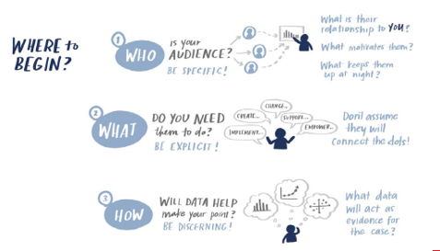
Visualisation Context
CASE Study
Summer Learning Programme
Clothing Retailer
DSE Electives
CANVAS
Higher Education
People Analyst

Slide 6
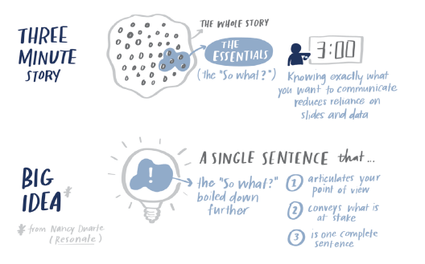

Slide 7
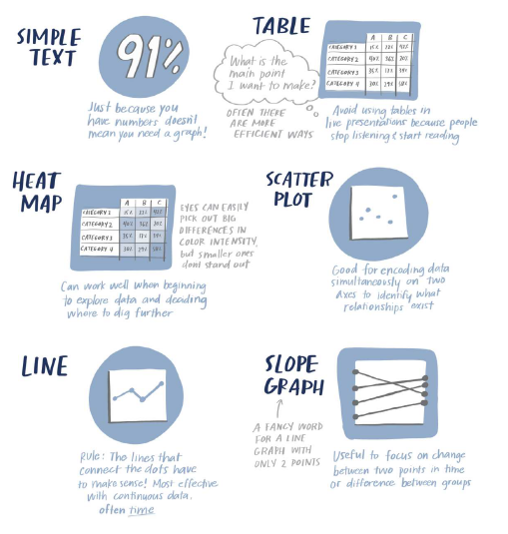
Types of Visuals

Slide 8
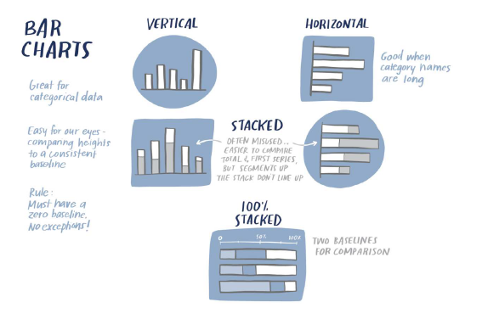
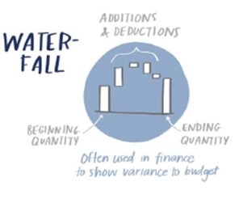
Types of Visuals
CASE Study
Summer Learning Programme
New Client Tier Share
Corporate Giving Programme(Canvas)
Capacity and Demand (Canvas)
Attrition rate(Canvas)
Graphs to be avoided

Slide 9

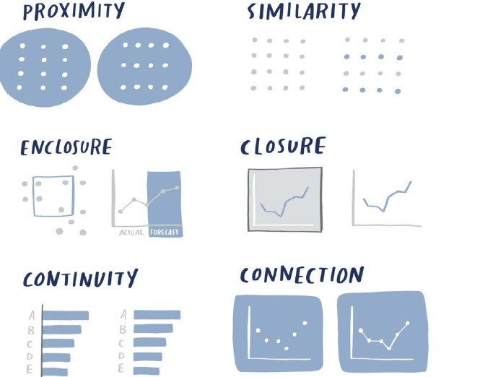
Visual Perception

Slide 10
Decluttering
USDA
Tickets Received an Processed
Demand and Capacity

Slide 11
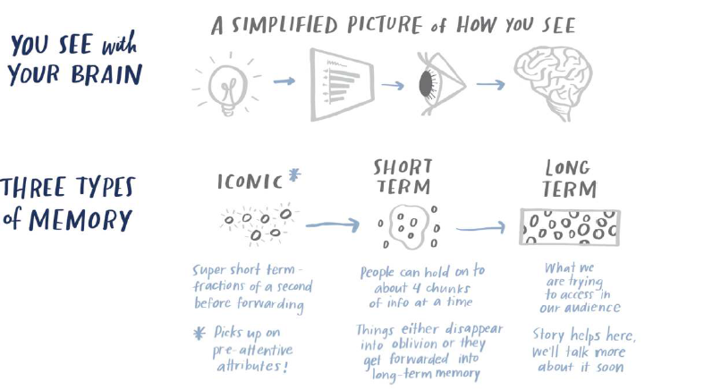
Preattentive Attributes

Slide 12
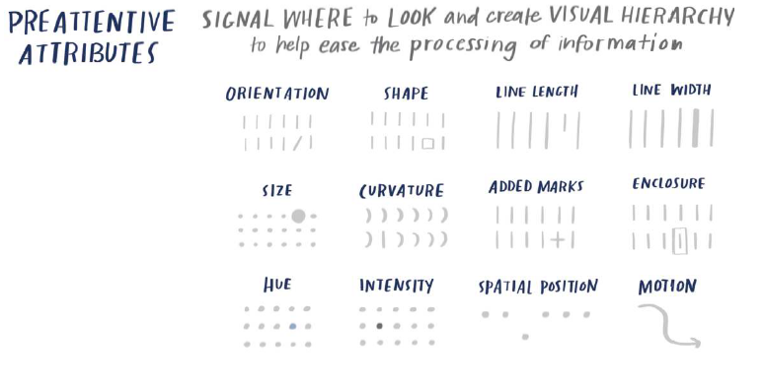
Pre attentive Attributes

Slide 13
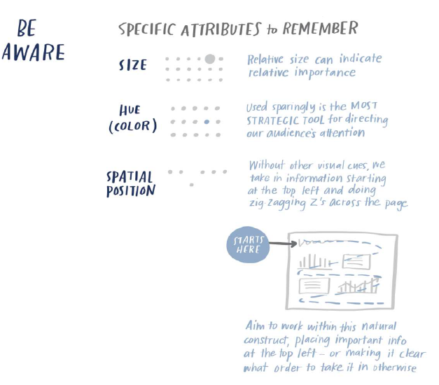
Pre attentive Attributes

Slide 14
Tableau Desktop Concepts: Intro

Slide 15
Tableau Desktop Concepts
Exhibit-1
The large selection of products comprises three main categories: office supplies (e.g., staples), furniture (e.g., chairs), and technology (e.g., smartphones)

Slide 16
Tableau Desktop Concepts
Exhibit-2
Global Superstore’s largest demand comes from the U.S., Australia, China, France, and Germany. We want to know the breakdown of sales by geography. For instance, is the United States more profitable than China for Global Superstore?

Slide 17
Tableau Desktop Concepts
Exhibit-3
As for their sales revenue, it surpassed $4 million in 2014, a 26% increase from 2013
Exhibit-4
Global Superstore’s order volume experienced a healthy growth; with more than 17,000 orders processed in 2014

Slide 18
SESSION 6 -PLAN
Different types of visuals
Table calculations
Problem solving using Tableau
Visual Analytics-Summary Card

Slide 19
Tableau Desktop Concepts: Answering Business Questions with Tableau.
Compare the frequency of the different shipping modes across the different order priorities.
Investigate the market wise sales
Sales and profit across different segments.
Analyse the monthly sales of subcategories for the year 2014

Slide 20
DIFFERENT TYPES OF VISUALS
Bar Chart
Line Chart
Text Tables
Heat Map
WaterFall Chart
Pie Chart
Scatterplot
Area Chart
Histograms
Dual Axis Chart
Bubble Chart
Maps

Slide 21
A FEW TABLE CALCULATIONS
FIRST()
INDEX()
LAST()
LOOKUP()
RANK()
SIZE()
TOTAL()
COMPUTE USING…(Table Across/Down)
WINDOW_AVG()

Slide 22
PROBLEM SOLVING USING TABLEAU

Slide 23
Questions -HW
What is the percent of total Sales for the ‘Home Office’ Customer Segment in July of 2012?
Find the top 10 Product Names by Sales within each region. Which product is ranked #2 in both the Central & West regions in 2011?
In the Technology Product Category, which unprofitable state is surrounded by only profitable states?
If 2013 Sales numbers were expected to increase by 50% in the following year, what would be the total estimated sales for the Consumer Segment in 2014?
In which Region do all Product Categories fall beneath the overall average profit?

Slide 24
Questions-HW
Which Product Sub-Category has a Shipping Cost to Sales ratio of above 3%?
Find the customer with the lowest overall profit. What is his/her profit ratio?
Look at the sum of profits for each Product Sub-Category. Which sub-category is $31,069 below the average profit across all categories?
What percent of total profits do the top 10 customer by Sales represent?
What was the Moving Average of Sales in June of 2012, including six months prior and six months after?

Slide 25
Questions-HW
Create a histogram showing the number of Sales using Sales Bins of $1,000. Which bins have profit ratios (profit as a percentage of sales) of more than 25%? (Select all that apply)
Investigate the average sales and profit per order by market, order category, and order subcategory. Do any patterns stand out?
Investigate which days of the week have faster shipping times. Which day should you place your order to get a fast shipping time?

Slide 26
Thank You!

